Slide 1

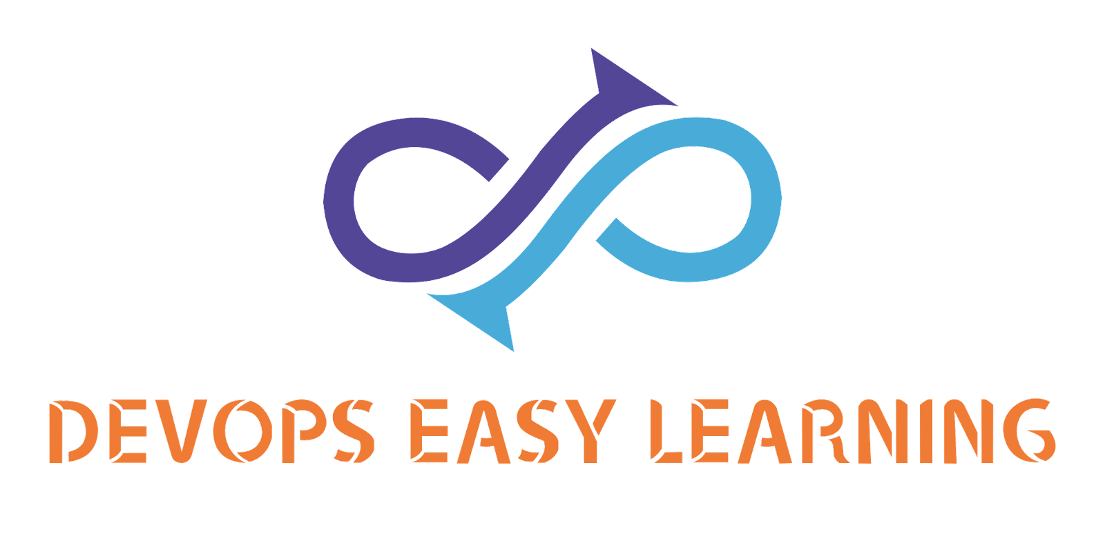
S6-Project
https://github.com/DEL-ORG/S6-PROJECTS

Slide 2
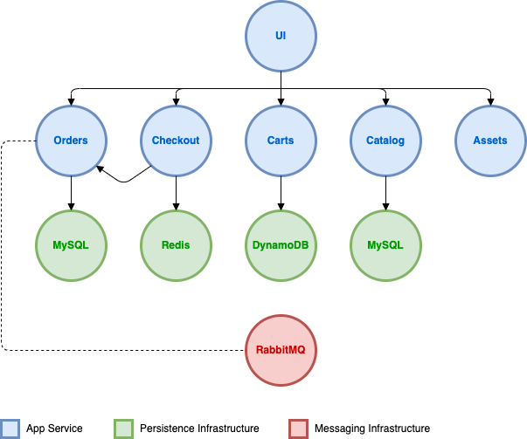
ARCHITECTURE
DevOps Easy Learning

Slide 3
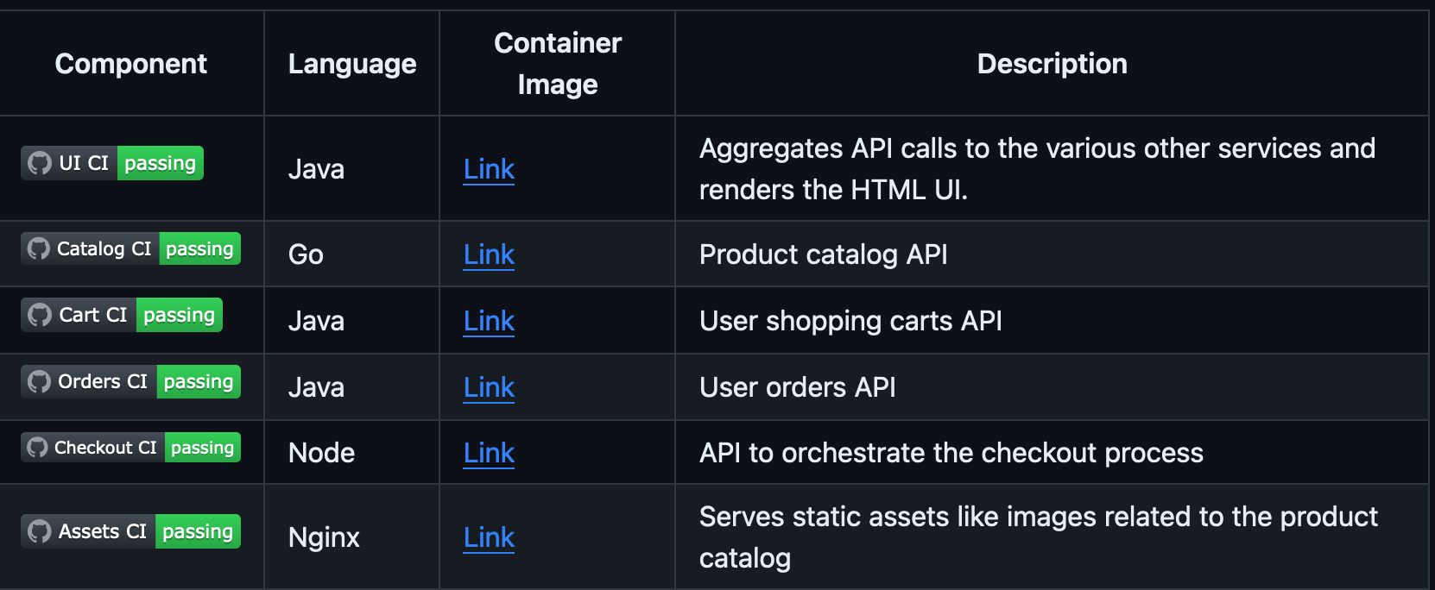
Code Language
DevOps Easy Learning

Slide 4
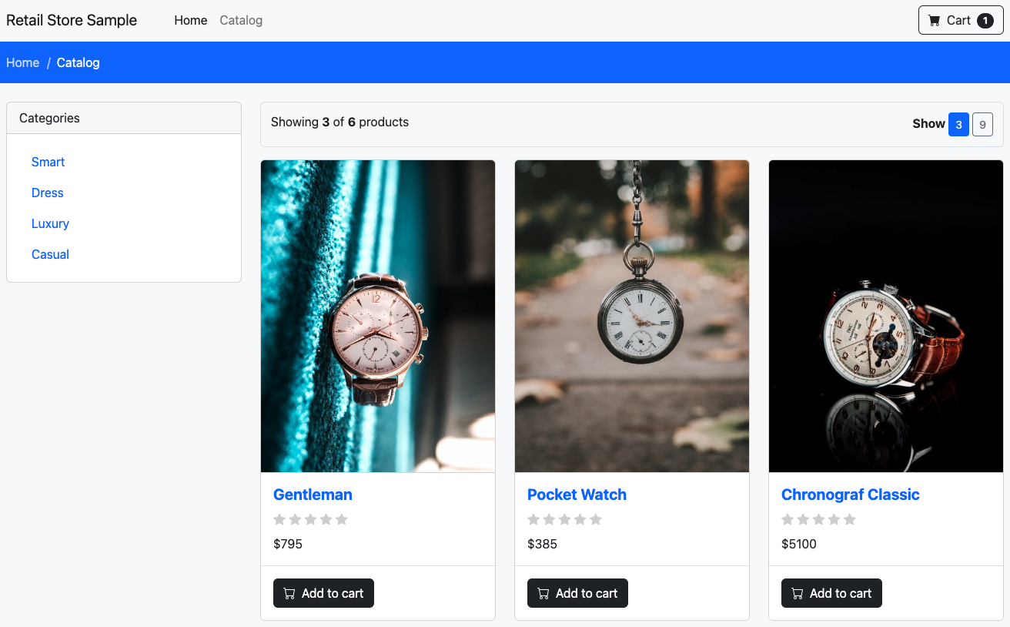
Output
www.revive.devopseasylearning.com

Slide 5
Overview
This project is dedicated to deploying Revive, an avant-garde e-commerce platform designed to transform the online shopping experience. By harnessing the capabilities of Helm for package management and ArgoCD for automated, continuous delivery within a Kubernetes environment, the project aims to establish a resilient, scalable, and efficient deployment pipeline. This infrastructure will serve as the backbone for Revive, supporting its mission to innovate within the e-commerce space.

Slide 6
Description
Revive seeks to redefine online shopping by introducing cutting-edge features, personalized shopping experiences, and seamless user interactions.
Its deployment into a production environment requires a sophisticated, robust approach that can accommodate rapid scaling, frequent updates, and high availability demands.
Utilizing Helm, Revive will be packaged into a manageable, deployable unit that simplifies version control and dependencies management.
In parallel, ArgoCD will automate the deployment process based on predefined configurations in a Git repository, ensuring that the deployment reflects the latest approved state of the application.
This combination promises a dynamic, reliable deployment workflow that aligns with Revive's innovative goals.

Slide 7
Project Goal
The primary goal of this project is to deploy the Revive application into a production environment using Helm for package management and ArgoCD for automated, continuous delivery.

Slide 8
Project Goal
The primary goal of this project is to deploy the Revive application into a production environment using Helm for package management and ArgoCD for automated, continuous delivery.

Slide 9
Objective
The primary goal of this project is to deploy the Revive application into a production environment using Helm for package management and ArgoCD for automated, continuous delivery.

Slide 10
Scalability
Ensure that the Revive application can be easily scaled up or down based on demand, leveraging Kubernetes' inherent scalability features.

Slide 11
Scalability for peak Demands
Ensure the infrastructure can dynamically scale to handle peak shopping periods, providing a seamless shopping experience without latency or downtime.

Slide 12
Manageability
Simplify the management of application deployments and updates through Helm's package management system, allowing for easy version control and rollback capabilities.

Slide 13
Automation
Utilize ArgoCD's GitOps approach to automate the deployment process, ensuring that the live production environment always matches the desired state as defined in the version-controlled repository.

Slide 14
Reliability
Increase the reliability and stability of the Revive application by enabling consistent, repeatable deployment processes and facilitating easy recovery in case of failures.

Slide 15
Efficiency
Reduce manual intervention in the deployment process, thereby increasing operational efficiency and allowing the development team to focus more on development and less on deployment logistics.

Slide 16
Security
Implement best practices and security measures throughout the deployment pipeline to protect the Revive application against vulnerabilities and threats. This includes securing the Helm chart configurations, managing sensitive information with Kubernetes secrets, and enforcing role-based access control (RBAC) in ArgoCD to ensure that only authorized personnel can initiate

Slide 17
Observability
ntegrate monitoring and logging tools into the deployment process to gain insights into the application's performance and health in real-time. This enables proactive troubleshooting and optimization, ensuring that the Revive application remains highly available and performs optimally under varying loads.

Slide 18
Continuous Improvement
Establish a framework for continuous feedback and improvement within the deployment process. This involves regularly reviewing the deployment pipeline for bottlenecks or inefficiencies, updating the Helm chart and ArgoCD configurations as the application evolves, and adapting to new Kubernetes features or best practices to enhance deployment effectiveness.

Slide 19
Collaboration and Communication
Foster a collaborative environment between development, operations, and other stakeholders involved in the deployment process. Utilize ArgoCD's integration capabilities with communication platforms to keep teams informed about deployment statuses, changes, and issues, thereby enhancing team coordination and accelerating issue resolution.

Slide 20
Compliance and Governance
Ensure that the deployment process complies with regulatory requirements and industry standards relevant to the application's domain. This includes configuring ArgoCD to enforce policies and checks that align with compliance standards, as well as maintaining clear documentation and audit trails for all deployment activities.

Slide 21
Security Compliance
Implement stringent security measures to protect customer data and transactions, adhering to e-commerce regulatory standards and best practices.

Slide 22
Personalization and Performance
Support advanced personalization features and high-performance interfaces, requiring the infrastructure to manage complex data and high-volume traffic efficiently.

Slide 23
Continue Optimization
Leverage insights from monitoring and logging to continuously optimize the platform, ensuring it remains fast, responsive, and ahead of customer expectations.

Slide 24
Collaboration Across teams
Foster a collaborative environment that bridges development, operations, marketing, and customer service teams, ensuring the deployment pipeline supports rapid feedback and feature incorporation.

Slide 25
Concluding
Achieving these additional objectives will not only streamline the deployment of the Revive application but also establish a solid foundation for its ongoing development, maintenance, and scaling. This comprehensive approach ensures that the application remains secure, efficient, and aligned with business goals, thereby maximizing its value and impact in the production environment.
The project will not only deploy the Revive e-commerce platform effectively but also lay the foundation for a continuous evolution that keeps pace with technological advancements and changing consumer behaviors, ensuring Revive leads the way in e-commerce innovation.

Slide 26
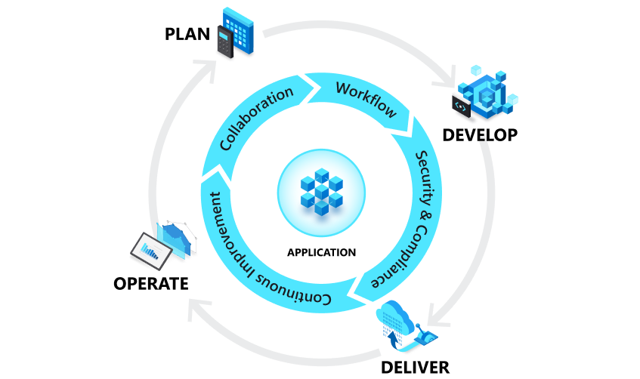
Enhanced Project Phases for Deploying Revice

Slide 27
Enhanced Project Phases for Deploying Revice

Slide 28


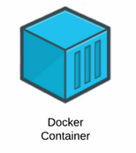

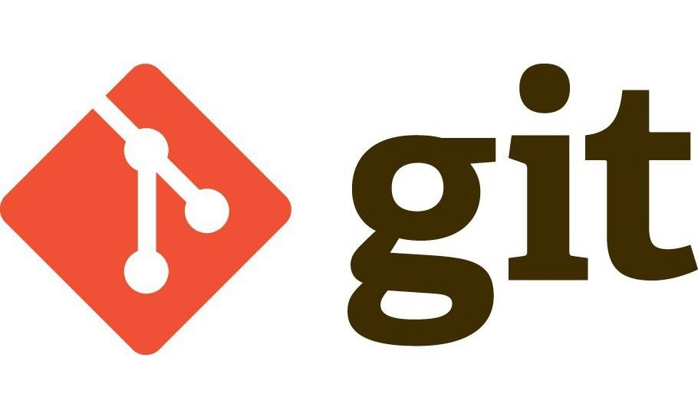

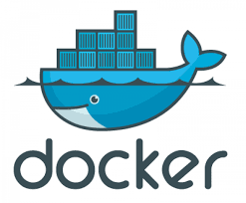
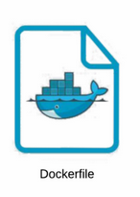

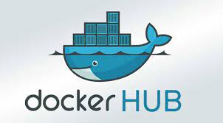
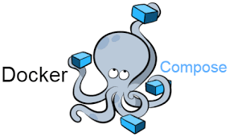


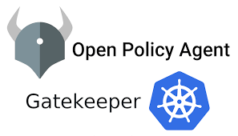


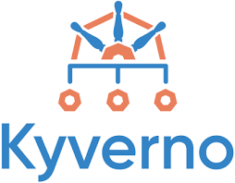

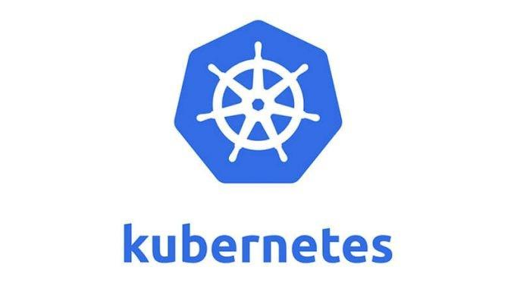

Enhanced Project Phases for Deploying Revice

Slide 29
Enhanced Project Phases for Deploying Revice
Phase 1: Meeting with Developers and Customers
Objective: Understand the technical and business requirements of the Revive platform. Gather insights on the desired features, performance expectations, security concerns, and user experience goals from both the development team and potential customers.
Activities: Conduct workshops or focus groups with customers to understand their needs and expectations. Hold technical sessions with the development team to align on the technological stack, deployment challenges, and scalability requirements.

Slide 30
Enhanced Project Phases for Deploying Revice
Phase 2: Meeting with Management
Objective: Secure buy-in and resources from management. Present the project scope, timeline, budget, and expected outcomes to ensure alignment with business goals and to obtain necessary approvals and support.
Activities: Prepare a comprehensive project proposal including the benefits of deploying Revive with Helm and ArgoCD, potential ROI, and a roadmap. Discuss risk management and contingency plans.

Slide 31
Enhanced Project Phases for Deploying Revice
Phase 3: Get Familiar with the Application Code
Objective: Ensure the project team fully understands the application's architecture, dependencies, and external integrations. This knowledge is crucial for creating an efficient deployment strategy.
Activities: Review the application's codebase, documentation, and architecture diagrams. Conduct code walkthroughs with the development team and identify any areas that may require changes or optimization for Kubernetes deployment.

Slide 32
Enhanced Project Phases for Deploying Revice
Phase 4: Get Familiar with the Application Microservices
Objective: Understand the interdependencies, communication patterns, and configurations of the microservices that compose the Revive application.
Activities: Review documentation and architecture diagrams specific to each microservice. Identify any external services or databases they interact with.

Slide 33
Enhanced Project Phases for Deploying Revice
Phase 5: Set Up Project Environment (Dev, Testing, Staging, Production)
Objective and activities as previously detailed, with an emphasis on creating isolated environments that mirror each other as closely as possible, allowing for accurate testing and staging before production deployment.

Slide 34
Enhanced Project Phases for Deploying Revice
Phase 6: Write the Docker-Compose File to Deploy the App
Objective: Containerize the Revive application and its microservices for local development and testing.
Activities: Define services, networks, and volumes in the docker-compose.yml file to orchestrate the containers' deployment. Ensure environmental variables and configuration files are correctly mapped.

Slide 35
Enhanced Project Phases for Deploying Revice
Phase 7: Setup Jenkins Server
Objective: Prepare Jenkins for automating the build, test, and deployment processes of the Revive application.
Activities: Install Jenkins on a server or as a container. Configure necessary plugins for Docker, Helm, and Kubernetes integration. Set up credentials and roles for secure access.

Slide 36
Enhanced Project Phases for Deploying Revice
Phase 8: Deploy the Application in Dev with Jenkins Using Docker-Compose as Proof of Concept (POC)
Objective: Validate the containerization approach and uncover potential issues early in the development cycle.
Activities: Create Jenkins pipelines that build the Revive application from source, deploy it using Docker Compose, and then run integration tests to validate the deployment.

Slide 37
Enhanced Project Phases for Deploying Revice
Phase 9: Perform Smoke Test on the Deployed Application
Objective: Quickly verify that all components of the application are correctly installed and functional.
Activities: Develop and run a series of basic tests on crucial functionalities to ensure the application's core features work as expected in the dev environment.

Slide 38
Enhanced Project Phases for Deploying Revice
Phase A: Planning Your Kubernetes Cluster
Objective: Define the requirements and architecture for the Kubernetes cluster that will host the Revive platform.
Activities:
Requirement Analysis: Assess the compute, storage, and network requirements based on the expected load, performance goals, and high availability requirements of the Revive platform.
Cluster Architecture Design: Decide on a single-cluster or multi-cluster architecture, considering factors such as geographical distribution, environment isolation (development, staging, production), and disaster recovery needs.
Select Infrastructure: Choose between self-managed on-premises, cloud-managed services (e.g., GKE, EKS, AKS), or hybrid deployments based on cost, scalability, and operational preferences.

Slide 39
Enhanced Project Phases for Deploying Revice
Phase B: Setting Up the Kubernetes Cluster
Objective: Deploy the Kubernetes cluster according to the planned architecture and configurations.
Activities:
Provision Infrastructure: Set up the underlying infrastructure for the cluster, including compute instances, networking, and storage, following the best practices for security and performance.
Install Kubernetes: For self-managed setups, install Kubernetes on your servers. For cloud-managed Kubernetes services, follow the provider's process to create and configure your cluster.
Configure Networking: Implement the chosen networking solution (e.g., Calico, Flannel, Weave) to enable pod-to-pod communication across nodes and clusters.
Set Up Storage: Configure persistent storage solutions for stateful workloads, using either cloud storage services (e.g., AWS EBS, Google Persistent Disk) or on-premises solutions (e.g., Ceph, NFS)

Slide 40
Enhanced Project Phases for Deploying Revice
Phase C: Cluster Security and Compliance
Objective: Implement security measures to protect the cluster and comply with best practices and regulatory requirements.
Activities:
Access Control: Configure RBAC policies to control access to Kubernetes resources, ensuring that users and applications have the minimum necessary permissions.
Secrets Management: Integrate a secrets management solution like HashiCorp Vault for handling sensitive information securely.
Network Policies: Apply network policies to restrict traffic flow between pods based on labels and ports, minimizing the risk of lateral movement in case of compromise.
Cluster Auditing and Logging: Enable auditing logs to track activities within the cluster. Set up a centralized logging solution to collect and analyze logs from containers, nodes, and Kubernetes components.

Slide 41
Enhanced Project Phases for Deploying Revice
Phase D: Ongoing Cluster Operations and Optimization
Objective: Ensure the Kubernetes cluster remains healthy, secure, and optimized for the Revive platform's needs over time.
Activities:
Updates and Upgrades: Regularly update and upgrade Kubernetes and its components to benefit from the latest features, bug fixes, and security patches.
Capacity Planning and Scaling: Monitor resource utilization and perform regular capacity planning exercises to adjust the size of the cluster as needed.
Disaster Recovery Planning: Implement backup and disaster recovery solutions for cluster data and stateful applications to minimize downtime and data loss in case of failures.

Slide 42
Enhanced Project Phases for Deploying Revice
Phase 10: Write Helm Charts for Each Microservice of the Application
Objective and activities as previously detailed, focusing on ensuring each microservice's Helm chart accounts for its unique configurations, dependencies, and scalability needs.

Slide 43
Enhanced Project Phases for Deploying Revice
Phase 10: Write Helm Charts for Each Microservice of the Application
Objective and activities as previously detailed, focusing on ensuring each microservice's Helm chart accounts for its unique configurations, dependencies, and scalability needs.

Slide 44
Enhanced Project Phases for Deploying Revice
Phase 11: Deploy Helm Chart Using Jenkins
Objective: Automate the deployment of microservices using Helm charts through Jenkins to streamline the process.
Activities: Configure Jenkins pipelines to package each microservice into a Helm chart and deploy them to the appropriate Kubernetes environment. This includes pulling code from version control, running Helm commands, and handling versioning.

Slide 45
Enhanced Project Phases for Deploying Revice
Phase 12: Setup ArgoCD
Objective and activities as previously detailed, with a focus on integrating ArgoCD with the Kubernetes environments and configuring it to monitor the repositories containing the Helm charts for continuous deployment.

Slide 46
Enhanced Project Phases for Deploying Revice
Phase 13: Deploy Using ArgoCD
Objective: Use ArgoCD to manage and automate the deployment of the Revive application's microservices in Kubernetes clusters.
Activities: Configure ArgoCD applications for each microservice, linking them to the corresponding Helm charts in Git repositories. Set up synchronization policies to automate deployment based on changes in the repositories.

Slide 47
Enhanced Project Phases for Deploying Revice
Phase 14: Implement Monitoring and Logging
Objective: Ensure visibility into the application's performance and health post-deployment.
Activities: Integrate monitoring and logging solutions like Prometheus, Grafana, and ELK Stack (Elasticsearch, Logstash, Kibana) with the Kubernetes cluster. Configure dashboards and alerts to monitor the health, performance, and availability of the Revive application and its microservices.

Slide 48
Enhanced Project Phases for Deploying Revice
Phase 15: Continuous Security Assessment
Objective: Maintain the security integrity of the Revive application through continuous assessment and updates.
Activities: Implement security scanning tools like Clair for container vulnerabilities, integrate security checks into the Jenkins pipeline, and conduct regular security audits. Update security policies and practices based on emerging threats.

Slide 49
Enhanced Project Phases for Deploying Revice
Phase 16: Feedback Loop for Continuous Improvement
Objective: Establish a process for ongoing optimization based on user feedback and system performance data.
Activities: Create channels for collecting user feedback, monitor application usage patterns, and analyze performance metrics. Use this information to prioritize feature updates, optimizations, and fixes. Regularly review and adjust the CI/CD pipeline for efficiency and effectiveness.

Slide 50
Enhanced Project Phases for Deploying Revice
Phase 17: Integrate SonarQube for Code Quality Analysis
Objective: Incorporate SonarQube into the CI pipeline to automatically analyze the codebase for bugs, vulnerabilities, code smells, and technical debt.
Activities:
Setup SonarQube Server: Install and configure SonarQube on a server or as a containerized service. Ensure it is accessible to the Jenkins server for scanning tasks.
Configure Jenkins Pipeline: Modify the Jenkins pipelines to include a step that triggers SonarQube analysis after the build process but before deployment. This ensures any code quality issues are caught early.
Analyze and Act on Feedback: Review SonarQube reports for each build. Prioritize and address issues based on severity and impact. Use this analysis to improve code quality continuously.

Slide 51
Enhanced Project Phases for Deploying Revice
Phase 18: Implement DataDog for Monitoring and Alerts
Objective: Leverage DataDog to monitor application performance, infrastructure health, and to gain operational insights through logs, metrics, and APM (Application Performance Monitoring).
Activities:
DataDog Setup: Sign up for DataDog and install the DataDog agent in your Kubernetes cluster. Ensure it has access to metrics, logs, and traces from the Revive application and its underlying infrastructure.
Configure Dashboards and Alerts: Create DataDog dashboards to visualize key performance metrics, log data, and infrastructure health. Set up alerts to notify the team of critical issues, performance degradation, or operational anomalies.
Integrate with CI/CD Tools: Configure DataDog to receive deployment markers from Jenkins and ArgoCD. This integration helps correlate deployment activities with changes in application performance or behavior.
Continuous Monitoring and Optimization: Use DataDog insights to identify performance bottlenecks, optimize resource usage, and improve the overall user experience. Regularly review operational data to make informed decisions about scaling, updates, and infrastructure adjustments.

Slide 52
Enhanced Project Phases for Deploying Revice
Phase 19: Continuous Learning and Process Improvement
Objective: Establish a culture of continuous learning and improvement based on insights gathered from SonarQube and DataDog, alongside other feedback mechanisms.
Activities:
Review and Reflect: Regularly schedule review sessions with the development, operations, and business teams to discuss insights from SonarQube and DataDog. Use these discussions to identify areas for improvement in code practices, deployment processes, and operational management.
Implement Changes: Based on the review sessions, implement changes to coding standards, deployment strategies, and operational practices. Ensure that improvements are documented and shared across teams.
Educate and Train: Provide ongoing training and resources to the team to adapt to new tools, technologies, and methodologies. Encourage a culture of learning and experimentation to continually enhance the Revive application's quality and performance.

Slide 53
Enhanced Project Phases for Deploying Revice
Phase 19: Continuous Learning and Process Improvement
Objective: Establish a culture of continuous learning and improvement based on insights gathered from SonarQube and DataDog, alongside other feedback mechanisms.
Activities:
Review and Reflect: Regularly schedule review sessions with the development, operations, and business teams to discuss insights from SonarQube and DataDog. Use these discussions to identify areas for improvement in code practices, deployment processes, and operational management.
Implement Changes: Based on the review sessions, implement changes to coding standards, deployment strategies, and operational practices. Ensure that improvements are documented and shared across teams.
Educate and Train: Provide ongoing training and resources to the team to adapt to new tools, technologies, and methodologies. Encourage a culture of learning and experimentation to continually enhance the Revive application's quality and performance.

Slide 54
Enhanced Project Phases for Deploying Revice
Phase 20: Integrate PagerDuty for Incident Management
Objective: Implement PagerDuty to manage incidents more effectively, ensuring that the right people are notified and can respond quickly to any issues that impact the Revive platform.
Activities:
Setup PagerDuty: Configure services and escalation policies in PagerDuty that reflect the team structure and availability. Integrate PagerDuty with monitoring tools like DataDog and any other systems that can detect anomalies or failures.
Define Incident Response Protocols: Establish clear protocols for incident response, including incident prioritization, communication plans, and post-mortem analyses. Ensure every team member knows their role during an incident.
Integrate with CI/CD and Monitoring Tools: Use PagerDuty's integrations to connect with Jenkins, ArgoCD, DataDog, and any other tools in the CI/CD pipeline. Configure these tools to automatically trigger alerts in PagerDuty based on specific events or metrics thresholds.
Conduct Incident Response Drills: Periodically simulate incidents to test the response protocols and PagerDuty configurations. Use the outcomes of these drills to refine the incident management process.

Slide 55
Enhanced Project Phases for Deploying Revice
Phase 21: Leverage Slack for Team Collaboration and Notifications
Objective: Utilize Slack as the central hub for team communication, collaboration, and notifications related to the development, deployment, and operation of the Revive platform.
Activities:
Configure Slack Channels: Set up dedicated Slack channels for different purposes, such as deployments, alerts, incident management, and general team communication. Ensure channels are appropriately named and used for their intended purposes.
Integrate with Development and Operational Tools: Connect Slack with Jenkins, ArgoCD, SonarQube, DataDog, and PagerDuty. Configure these tools to send notifications to the relevant Slack channels. This could include deployment successes/failures, code quality reports, performance alerts, and incident notifications.
Facilitate Real-Time Communication: Encourage the team to use Slack for real-time discussions, troubleshooting, and decision-making. This ensures that information is shared promptly and decisions can be made swiftly.
Implement Slack Bots and Automation: Explore Slack bots and automation for routine tasks, such as deploying a new build, fetching logs, or creating incident reports. These bots can increase efficiency and reduce the time spent on repetitive tasks.

Slide 56
Enhanced Project Phases for Deploying Revice
Phase 22: Continuous Feedback and Improvement Loop
Objective: Foster a culture of continuous feedback and iterative improvement, leveraging the insights and communication channels established through PagerDuty and Slack.
Activities:
Regular Review Meetings: Hold regular meetings to discuss recent incidents, deployment outcomes, and performance trends. Use information from PagerDuty incidents and Slack communications as a basis for these discussions.
Actionable Insights: Turn insights from incidents and team discussions into actionable improvements. This might involve changes to code, infrastructure, monitoring thresholds, or team processes.
Knowledge Sharing: Use Slack to share learnings from incidents, deployments, and other challenges. Encourage team members to contribute solutions, tips, and documentation to help others learn from their experiences.
Iterative Process Adjustments: Continuously refine the development, deployment, and operational processes based on team feedback, incident retrospectives, and performance analyses. Ensure changes are communicated across the team and integrated into existing workflows.

Slide 57
Enhanced Project Phases for Deploying Revice
Phase 23: Integrate Kyverno for Kubernetes Policy Management
Objective: Implement Kyverno in the production Kubernetes cluster to enforce security standards, best practices, and organizational policies automatically, ensuring that the Revive e-commerce platform operates securely and efficiently.
Activities:
Install Kyverno on the Production Cluster: Deploy Kyverno as an admission controller in the Kubernetes cluster. This can be done using Helm charts or directly applying Kyverno deployment YAMLs.
Define and Implement Policies: Identify the specific security, compliance, and operational policies that are relevant to the Revive platform. This could include policies for resource quotas, security contexts, ingress standards, and labeling conventions. Write Kyverno policies in YAML format and apply them to the cluster.
Test Policies in a Controlled Environment: Before enforcing the policies in the production environment, test them in a staging or development environment. Ensure that the policies achieve the desired effect without unintended side effects or disruptions to legitimate deployments.

Slide 58
Enhanced Project Phases for Deploying Revice
Phase 24: Integrate Gatekeeper for Kubernetes Policy Management
Objective: Deploy Gatekeeper in the production Kubernetes cluster to enforce predefined policies, thereby ensuring that all resources comply with the organization’s security, operational, and compliance standards.
Activities:
Install Gatekeeper: Deploy Gatekeeper to your Kubernetes cluster. This usually involves applying a set of Kubernetes manifests that include the Gatekeeper Controller Manager and necessary Custom Resource Definitions (CRDs) for configuring policies.
Define Policies (Constraints and Templates): Identify the specific requirements for your Kubernetes resources related to security, naming conventions, resource limits, and other best practices. Define these policies using ConstraintTemplates and then create Constraints to enforce these policies on the cluster.
Policy Testing in Non-Production Environments: Before applying policies in the production environment, test them in a development or staging environment. This helps to ensure that policies work as intended without impacting application functionality.

Slide 59
Enhanced Project Phases for Deploying Revice
Phase 24: Integrate Gatekeeper for Kubernetes Policy Management
Objective: Deploy Gatekeeper in the production Kubernetes cluster to enforce predefined policies, thereby ensuring that all resources comply with the organization’s security, operational, and compliance standards.
Activities:
Install Gatekeeper: Deploy Gatekeeper to your Kubernetes cluster. This usually involves applying a set of Kubernetes manifests that include the Gatekeeper Controller Manager and necessary Custom Resource Definitions (CRDs) for configuring policies.
Define Policies (Constraints and Templates): Identify the specific requirements for your Kubernetes resources related to security, naming conventions, resource limits, and other best practices. Define these policies using ConstraintTemplates and then create Constraints to enforce these policies on the cluster.
Policy Testing in Non-Production Environments: Before applying policies in the production environment, test them in a development or staging environment. This helps to ensure that policies work as intended without impacting application functionality.

Slide 60
Enhanced Project Phases for Deploying Revice
Phase 25: Integrate HashiCorp Vault for Secrets Management
Objective: Deploy HashiCorp Vault within the Kubernetes cluster to manage secrets and sensitive information securely for the Revive platform, ensuring that access to these secrets is tightly controlled and audited.
Activities:
Vault Installation and Configuration: Deploy Vault on Kubernetes, either using the official Helm chart for ease of deployment or manually configuring it for more customized setups. Ensure Vault is configured in high-availability mode to prevent downtime.
Secrets Organization and Access Control: Define a structure for organizing secrets within Vault, considering different environments (dev, staging, production) and aspects of the Revive platform. Utilize Vault's policies to control access to secrets based on roles and responsibilities within the team.
Dynamic Secrets Integration: Where applicable, configure Vault to generate dynamic secrets for databases or other services that the Revive platform interacts

Slide 61
Enhanced Project Phases for Deploying Revice
Phase 26: Continuous Security and Compliance Assessment
Objective: Establish ongoing processes to review and update secrets management practices, ensuring they comply with evolving security policies and regulatory requirements.
Activities:
Regular Review of Secrets and Policies: Schedule periodic reviews of stored secrets, access policies, and authentication methods to ensure they align with current security standards and the least privilege principle.
Automate Secrets Rotation and Management: Implement automation around the rotation of dynamic secrets and the revocation of unused credentials to minimize the risk of secrets being leaked or misused.
Training and Awareness: Conduct regular training sessions for the development and operations teams on best practices for managing secrets with Vault, including how to securely access and use secrets in applications.

Slide 62





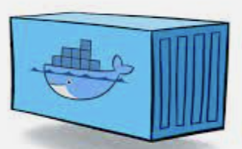




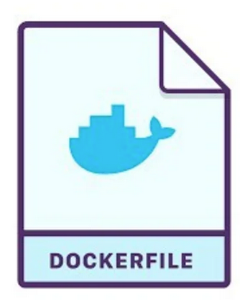
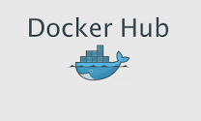





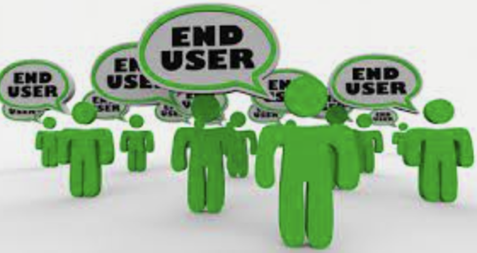
DEVELOPMENT PIPELINE (When pull request merged to develop branch)
4
5
Test: go test
Test: maven test
3
1
7
8
2
6
12
13
10
11
14
9
Build .exe
Build .war
15
17
2
3
16
1
18

Slide 63


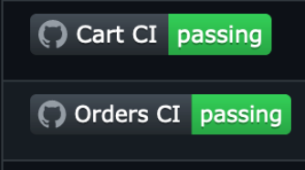
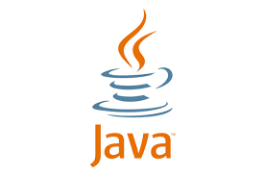

DEVELOPMENT PIPELINE (When pull request merged to develop branch)
1
A pull request (PR) is merged in the develop branch (develop is the main branch for development and accept only code change by pull request)
2
notice the change on stormer repository via a preset webhook then clone the repository
3
Jenkins send build start notification on
4
Jenkins use the docker agent to launch a golang container to scan the all go code
5
Jenkins use the docker agent to launch a container to scan the all code

Slide 64
DEVELOPMENT PIPELINE (When pull request merged to develop branch)
6
use the docker agent to launch container to scan the code and the scan result sent back to
7
sent the build report to to be compared with quality gate
8
sent the code analysis result back to
9
Jenkins use the docker agent to launch containers to build an artifact
10
Jenkins use the docker agent to launch containers to build an artifact

Slide 65
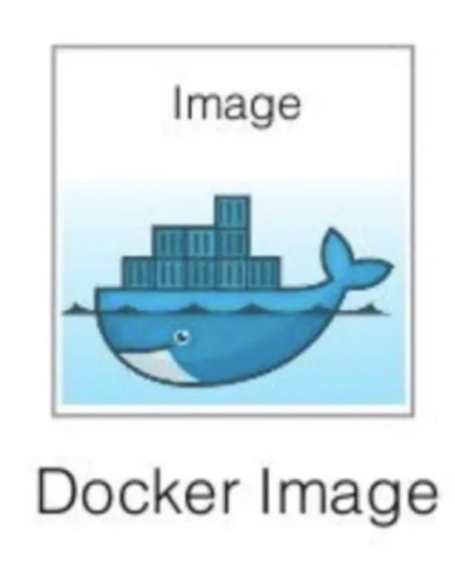
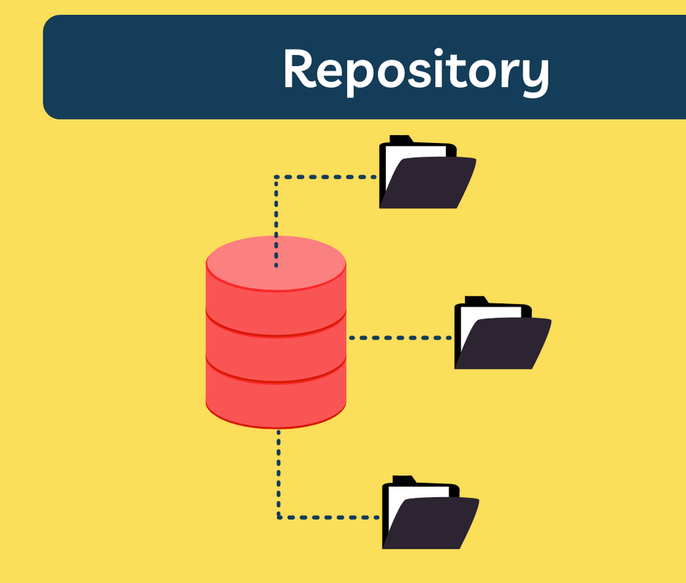


DEVELOPMENT PIPELINE (When pull request merged to develop branch)
11
read to build all docker then push all of them to
12
Jenkins the charts on then update value.yaml file with new image tag
13
Jenkins commit back the new charts back into
14
notice the change on the on helm charts located on

Slide 66


DEVELOPMENT PIPELINE (When pull request merged to develop branch)
15
Invoke
16
to deploy in to
17
to deploy pull docker from
18
is available on the browser for

Slide 67




DEVELOPMENT PIPELINE (When pull request merged to develop branch)
1
agent notice and incident on the cluster and notify
2
ag notify the devops engineer on call by
3
ag notify the devops team on

Slide 68

DEVELOPMENT PIPELINE (When a code is changed on all branches except develop)
4
5
Test: go build
Test: maven test
3
1
7
8
2
6
11
9
10
Build .exe
Build .war
This pipeline on make sure an image can be built from the change made on the code

Slide 69
DEVELOPMENT PIPELINE (When pull request merged to develop branch)
1
a new branch is created or a commit is made to on of the branch
2
notice the change on stormer repository via a preset webhook the clone the repository
3
Jenkins send build start notification on
4
Jenkins use the docker agent to launch a golang container to scan the all go code
5
Jenkins use the docker agent to launch a container to scan the all code

Slide 70
DEVELOPMENT PIPELINE (When pull request merged to develop branch)
6
use the docker agent to launch container to scan the code and the scan result sent back to
7
sent the build report to to be compared with quality gate
8
sent the code analysis result back to
9
Jenkins use the docker agent to launch containers to build an artifact
10
Jenkins use the docker agent to launch containers to build an artifact

Slide 71

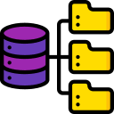
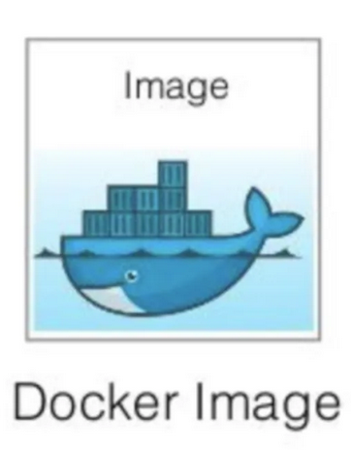
DEVELOPMENT PIPELINE (build and push specific tag )
1
3
4
2
5
This pipeline is used to tag image and push to DockerHub when everything is ok on dev side

Slide 72

DEVELOPMENT PIPELINE (Deploy a specific branch using K8S )
3
4
Test: go build
Test: maven test
2
1
6
7
5
11
12
9
10
13
8
Build .exe
Build .war
14
16
2
3
15
1
17

Slide 73

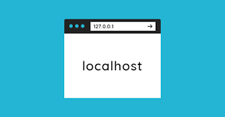
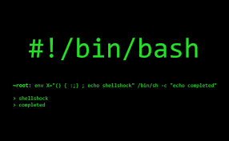

DEVELOPMENT PIPELINE (Deploy a specific branch using Docker-compose )
1
8
4
2
5
7
3
6

Slide 74

QA PIPELINE
1
3
2
4
5

Slide 75
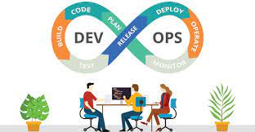
PREPROD PIPELINE
1
2
5
3
4
5
6
8
2
3
7
1
9

Slide 76

PROD PIPELINE
1
2
3
4
5
6
8
2
3
7
1
9

Slide 77

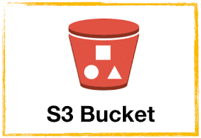
DB PIPELINE automate backup
1
4
3
2

Slide 78
DB PIPELINE Restore backup
1
3
4
2

